Slide 1
CANTEEN TOKEN &
ORDER QUEUE SYSTEM
Digitizing the campus canteen — one token at a time.
SDA Project Report · Department of Computer Science Faculty of Science and Information Technology · Sukkur IBA University Submitted to: Sir Babar Sheikh · April 2026
TEAM
Anees Ahmed (053-24-0009)
Zohaib Ahmed (053-24-0012)
Ghulam Mujtaba (053-24-0023)
Abdul Baseer (053-24-0004)

Slide 2





PROBLEM STATEMENT
Problem & Motivation
Time Waste
Miscommunication
No Tracking
Long physical queues during peak hours waste student and staff time
Verbal orders cause wrong food to get prepared — no written record
Customers have no way to track orders without standing at the counter
Staff Struggle
No Analytics
Canteen staff lack a structured system to manage multiple orders
Admin cannot analyse demand or manage the menu — zero order records
"We replaced the chaos with a token."

Slide 3




REQUIREMENTS
Stakeholders & Scope
Customer
Canteen Staff
Admin
Student / Staff
Browses menu, places orders, tracks status via token
Views order queue, updates status at each preparation stage
Manages menu items, views daily order reports and dashboard
IN SCOPE
OUT OF SCOPE
Digital menu browsing & order placement
Automatic token generation (daily reset)
FIFO queue management & position tracking
Real-time order status tracking
Admin control panel for menu & reports
Online payment integration
Delivery to classrooms or offices
Inventory / stock management

Slide 4






REQUIREMENTS
Functional Requirements
Authentication & Roles
Menu Management
Order Placement
FR-01: Register with university ID, name & password
FR-03: Separate roles — Customer, Staff & Admin
FR-04: Display categorized menu with name, price, description
FR-05: Admin can add, edit & remove menu items
FR-07: Customer selects one or more items from the menu
FR-09: Confirm order → automatically added to the queue
Token Generation
Queue & Status
Notifications & Reports
FR-10: Unique sequential token per confirmed order
FR-12: Token numbers reset to 1 each operating day
FR-13: All orders managed in FIFO order
FR-16: Four statuses: Pending → Preparing → Ready → Collected
FR-19: Customer notified on-screen when order status → Ready
FR-25: Admin dashboard: total, pending & completed counts

Slide 5





REQUIREMENTS
Non-Functional Requirements
Performance
Security
Usability
Reliability
Scalability
< 3s page load
Hashed passwords
Responsive design
99% uptime
Modular architecture
Supports 100 concurrent users without degradation
Session-based auth + role-based access control (RBAC)
Works on mobile & desktop — no training required
Guaranteed during all canteen operating hours
Add counters or locations with zero restructuring

Slide 6
REQUIREMENTS
Use Cases
Actor: Customer
Actor: Canteen Staff
Browse & search menu items
Place and confirm order
Receive token number
Track order status in real-time
Cancel a pending order
View live order queue
Change order status (Preparing / Ready / Collected)
Manage multiple orders simultaneously
Actor: Admin
Actor: System
Add / Edit / Remove menu items
View daily order report & dashboard
Monitor pending and completed orders
Auto-generate sequential token
Reset token counter daily
Send on-screen notification on status change
Maintain FIFO queue order

Slide 7
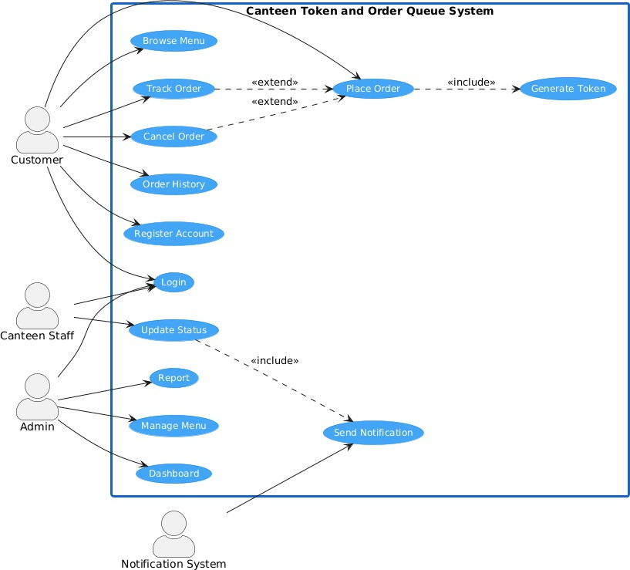
REQUIREMENTS
Use Case Diagram
Note: Replace with your actual UML use case diagram image in the final submission.

Slide 8
ARCHITECTURE
Architecture Style & Justification
Tier 1
Web pages the user sees and interacts with
Why Three-Tier?
Presentation Layer
Clear separation of concerns — one responsibility per layer
UI changes do not affect business logic or data
Simple and well-suited for a small-scale web system
Each layer independently maintainable and testable
Supports future scalability — add new canteen locations
HTML · CSS · JavaScript
Tier 2
Token generation, queue management, order processing
Business Logic Layer
PHP
Tier 3
Stores users, orders, tokens, menu items
Data Layer
MySQL

Slide 9


ARCHITECTURE
System Components & Interaction
Auth Module
Menu Module
Order Management
Token Generation
Login, session management, role-based access
Display items; admin can add / edit / remove
Core module: placement, confirmation, status, cancellation
Unique sequential token per order; daily reset to 1
Queue Management
Notification Module
Admin Dashboard
FIFO queue; auto-updates position as orders complete
Triggers on status change → alerts customer on-screen
Daily totals, pending counts, menu control, report generation
Data Layer (MySQL) — all modules communicate here via PHP backend

Slide 10
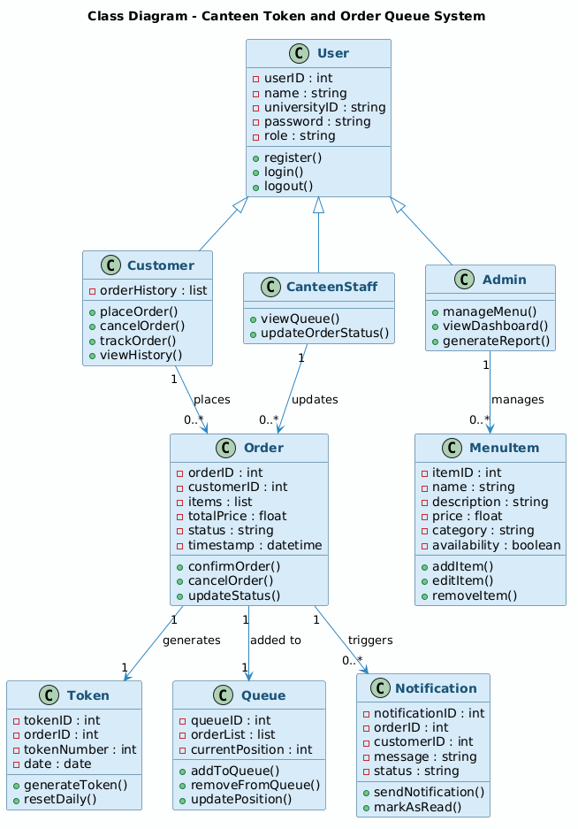
UML DIAGRAMS
Class Diagram
[ Insert Class Diagram Image Here ]
User (parent)
→ Customer, CanteenStaff, Admin — Inheritance hierarchy
Order
Core entity — Links to Token, MenuItem, Notification
Token
Unique per order — Resets daily to 1
MenuItem
Managed by Admin — name, price, category, status
Notification
Triggered on change — Fires when status → Ready

Slide 11
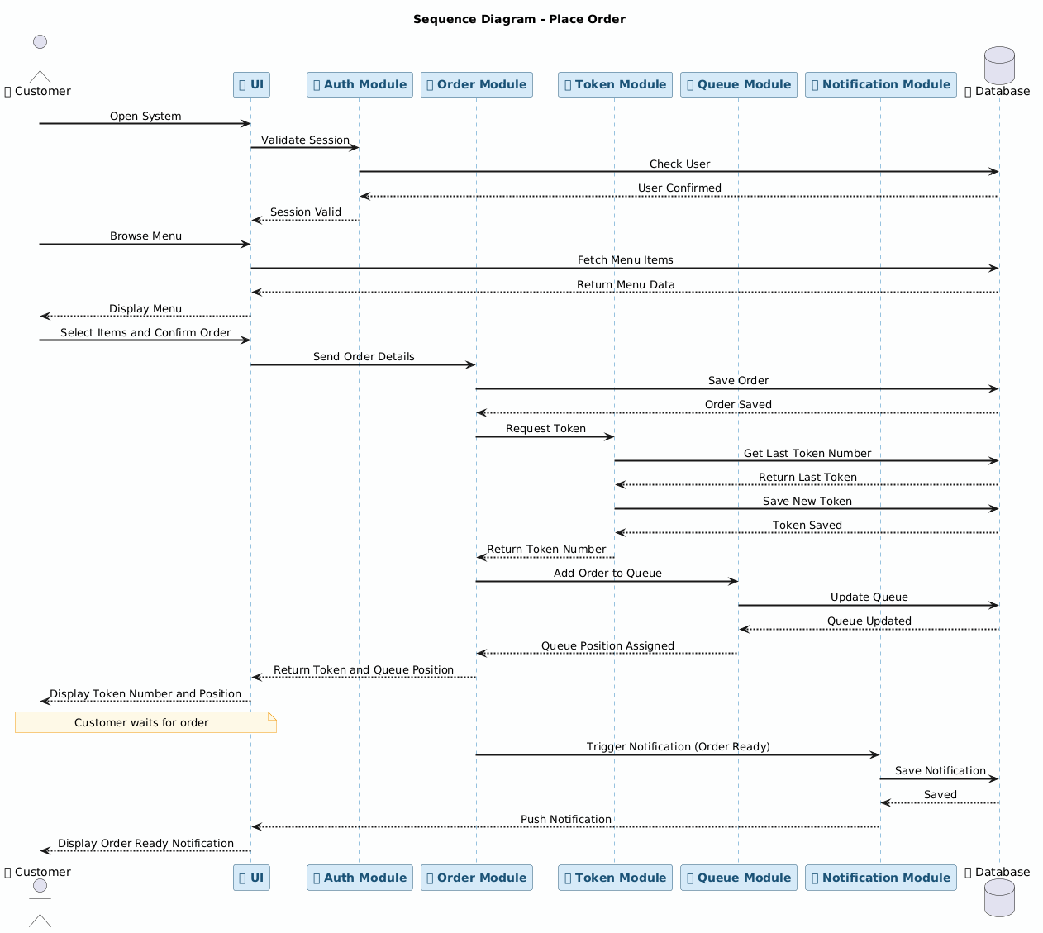
UML DIAGRAMS
Sequence Diagram — Place Order Flow
[ Insert Sequence Diagram Image Here ]
Flow Walkthrough
1
Customer selects items from menu
2
Customer clicks Confirm Order
3
System validates and generates token
4
Order added to FIFO queue
5
Staff view updated with new order
6
Staff marks order status as Ready
7
Customer notified on-screen

Slide 12


ARCHITECTURE
Deployment Architecture
Client Node
Server Node
Database Node
[ Browser ]
→
[ Server ]
→
[ DB ]
Web Browser
(Any device — mobile or desktop)
Apache + PHP
via XAMPP
MySQL
managed via phpMyAdmin

Slide 13
UML DIAGRAMS
Design Patterns
Singleton
Factory
Observer
DatabaseManager
UserFactory
Order → NotificationModule
WHY
WHY
WHY
Prevents multiple DB connections; saves memory and ensures consistency
Centralises user object creation logic — one place to manage all roles
Customers are auto-notified on status change without constant polling
HOW
HOW
HOW
Private static instance + getInstance() method ensures one shared connection throughout the app lifecycle
createUser(role) returns Customer, CanteenStaff, or Admin based on the role field in the database
Order (subject) calls notifyObservers() → NotificationModule (observer) fires the on-screen alert

Slide 14




IMPLEMENTATION
Technology Stack & Prototype Features
Frontend
Backend
HTML · CSS · JavaScript
PHP
Responsive web pages for customer, staff, and admin interfaces
Handles orders, token generation, queue logic, and form processing
Database
Tools
MySQL
XAMPP · phpMyAdmin · VS Code
Stores all data: users, orders, tokens, menu items, notifications
Local server environment, database GUI, and code editor
PROTOTYPE COVERS
ALSO INCLUDES
Role-based login · Menu browsing · Order confirmation · Token display · Queue management
Staff queue interface with status updates · Admin dashboard with daily counts & menu control

Slide 15
IMPLEMENTATION
Code Structure & Organization
Folder structure mirrors the three-tier layered architecture
/views
Tier 1 — Presentation
All HTML and CSS files for customer, canteen staff, and admin interfaces
/controllers
Tier 2 — Business Logic
PHP files handling requests: order logic, token generation, queue management
/models
Entity Classes
PHP classes: User, Order, MenuItem, Token, Notification
/database
Tier 3 — Data Layer
DB connection file and all SQL queries for CRUD operations
Tip: Include a screenshot of your VS Code folder structure in the final build.

Slide 16
TESTING
Testing Strategy & Results
Unit
Integration
Functional
UAT
Boundary
Each module tested independently (e.g. token generation resets daily)
Modules tested together (e.g. Order → Token → Queue)
Each functional requirement verified against expected output
Real-world scenarios from end-user perspective
Edge cases: empty queue, cancelling a Preparing order, wrong credentials
TC
Module
Expected Outcome
Status
TC-01
Authentication
Valid login → redirected to dashboard
Pass
TC-02
Authentication
Wrong password → error message shown
Fail*
TC-03
Order Placement
Items confirmed → order queued + token shown
Pass
TC-04
Token Generation
Unique sequential token generated
Pass
TC-05
Cancellation
Pending order cancelled → removed from queue
Pass
TC-06
Status Update
Staff marks Ready → customer notified
Pass
TC-07
Menu Management
Empty fields → validation error shown
Fail*
* TC-02 and TC-07 are known issues — input validation not yet implemented

Slide 17


CONCLUSION
Limitations & Future Work
Current Limitations
Future Recommendations
No online payment — cash only at collection point
Notifications are on-screen only (no SMS or email)
Local network deployment — not accessible outside campus
No inventory or stock management module
Reporting limited to basic daily order counts
Integrate online payment gateway (JazzCash / EasyPaisa)
Add SMS and email notification support
Migrate to cloud hosting for campus-wide access
Build a dedicated mobile application (iOS & Android)
Add inventory and stock management module
Implement advanced analytics and trend reports

Slide 18





CONCLUSION
Conclusion
"We digitized the canteen queue using a token-based web system built on three-tier layered architecture."
Problem Solved
Architecture
Patterns
Prototype
Testing
Eliminated physical queuing and order miscommunication
Three-tier layered design — Presentation, Logic, Data
Singleton, Factory, and Observer patterns applied
Working system covering all core functional requirements
5 test types · 7 test cases · 5 passing

Slide 19
Thank You
Questions Welcome
Submitted to: Sir Babar Sheikh · Dept. of Computer Science · Sukkur IBA University · April 2026

